Slide 1
Capstone Project
Customer Segmentation

Slide 2
Content
Some EDA
Dealing with missing Values
Dealing with cancelled/Returned orders
Transaction’s Frequency (Count)
– Year, Month, Day and Time
Transaction’s Amount (Sum)
– Year, Month, Day and Time
Model Preparation
Model
Cluster Visualization

Slide 3
Problem Statement
Identifying major customer segments on a transactional data

Slide 4
Data Summary
Data set name – Online Retail
Shape of Dataset- 541909 rows, 8 columns
Columns - 'InvoiceNo', 'StockCode', 'Description', 'Quantity', 'InvoiceDate', 'UnitPrice', 'CustomerID', 'Country'

Slide 5
Some EDA
Dealing with missing Values
Column “customerID” had null values – this was the main thing, because we can not fill these values with any of the number, as these are customers only, so we had to remove them.
Dealing with Cancelled/Returned products
Column “InvoiceNo”, was the one from which we could see the cancelled order – I have just dropped those rows, because those were not required for clustering
I have split the “Date” into Month, Year, day, and Hour, and removed the duplicate entries.

Slide 6
Some EDA
Transaction’s Frequency (Count)
– Year, Month, Day and Time
Here I have plotted some graphs showing the total number of products sold and sum of products sold

Slide 7
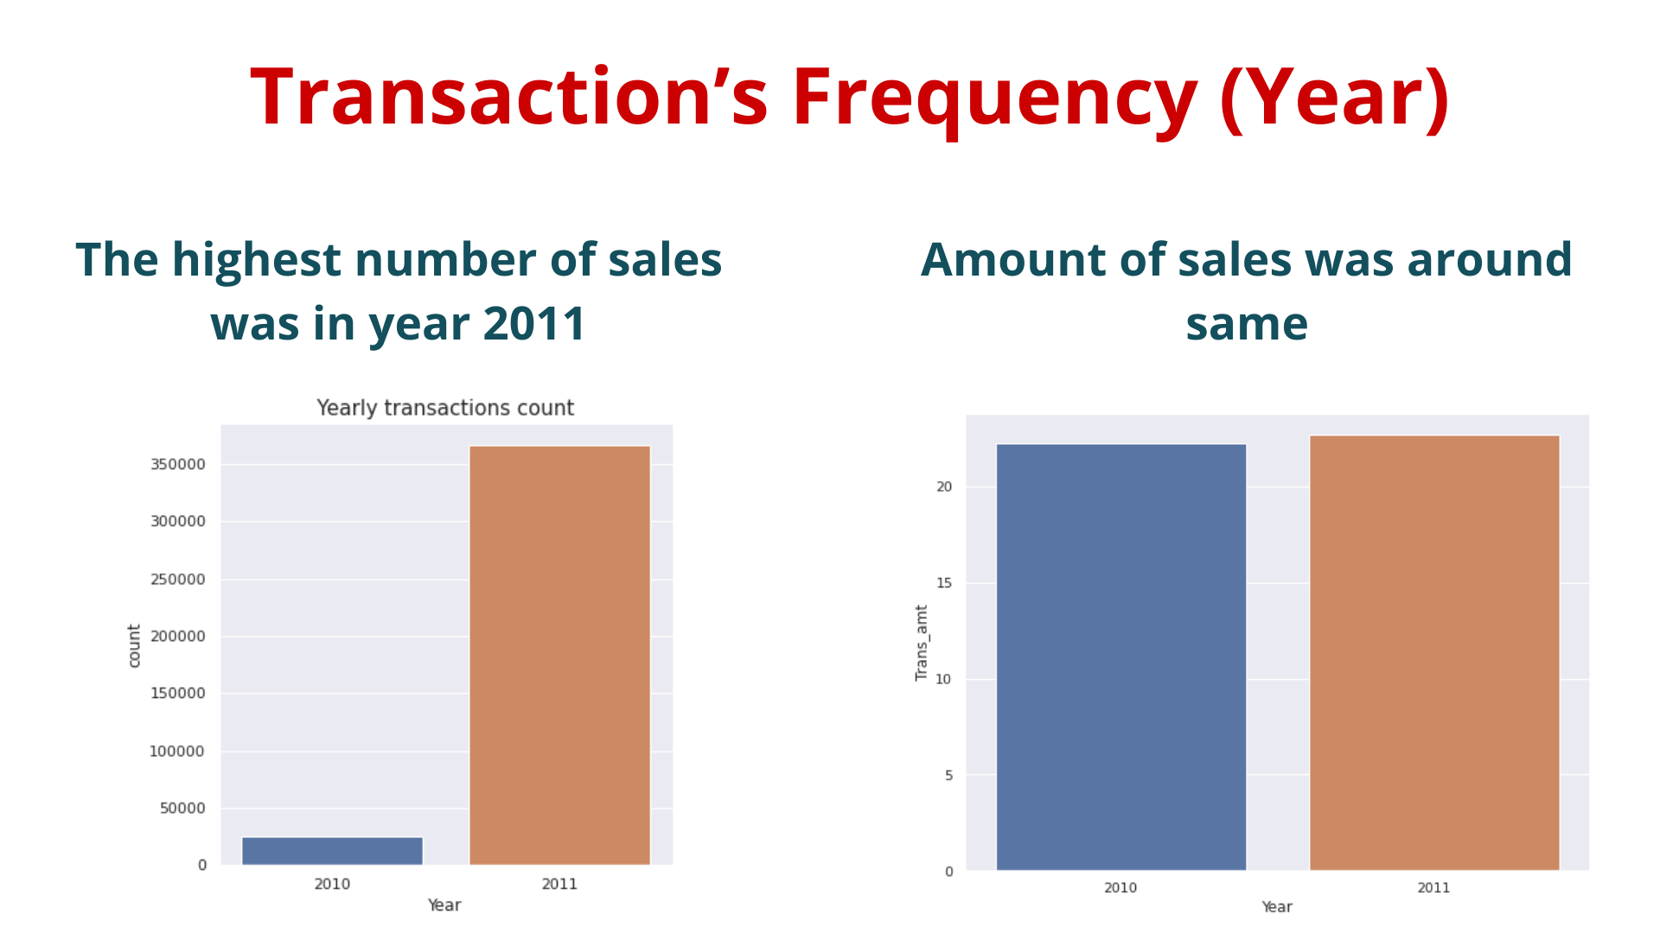

Slide 8
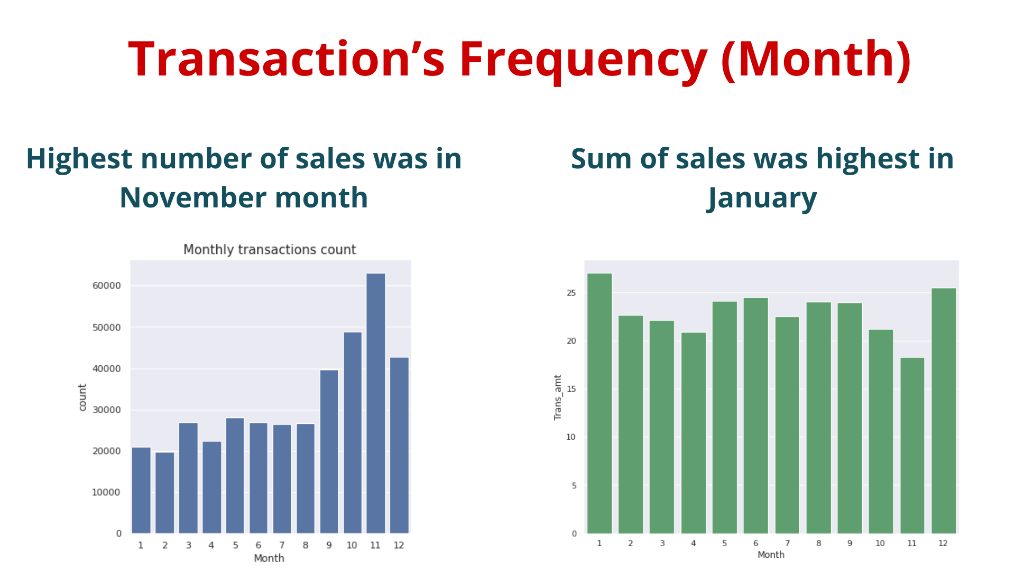

Slide 9
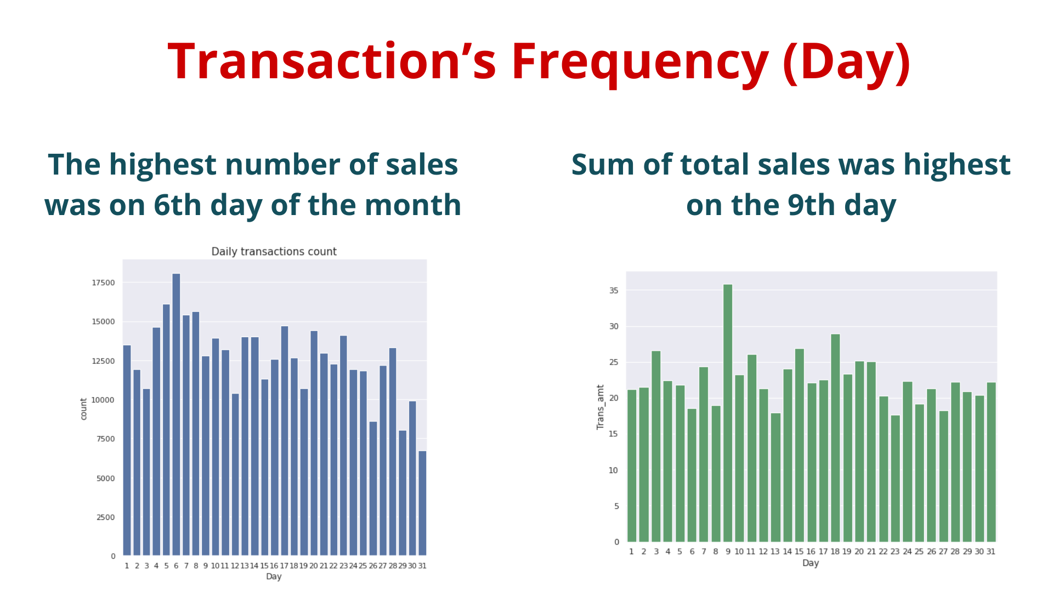

Slide 10
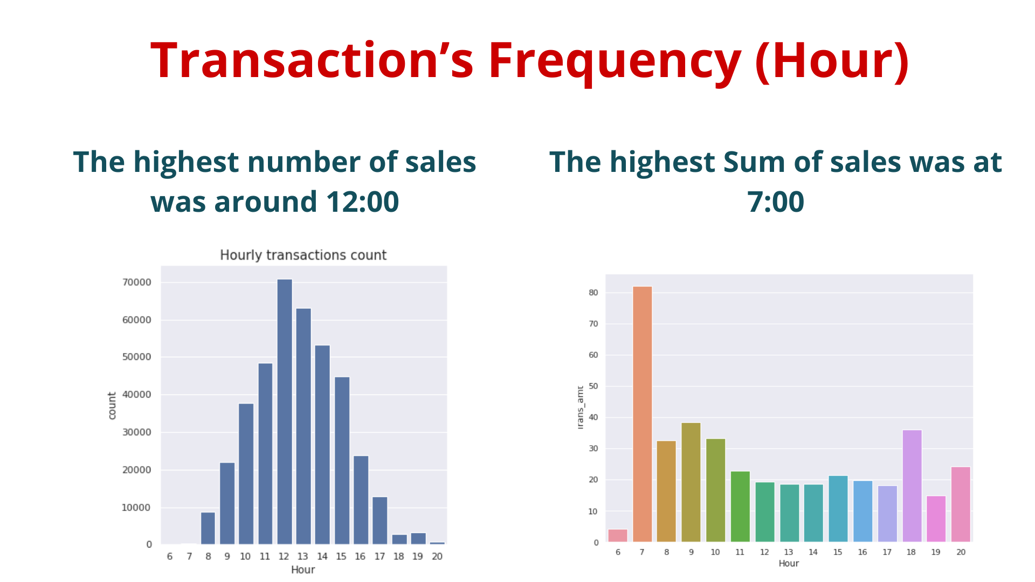

Slide 11
Model Preparation
Here I have converted this dataframe into different in which I have put three columns only
Frequency – Total number of products purchased by a customer
Total_Trans_amt – Sum of the money a customer has spent on products
Last_purchase – last transaction of a customer (Days)

Slide 12
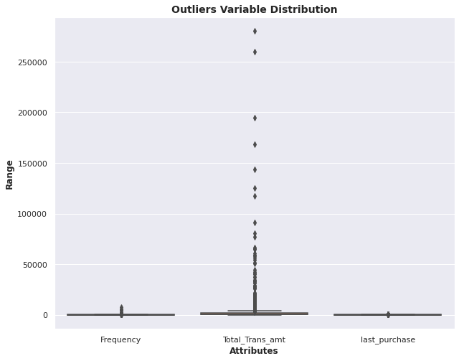
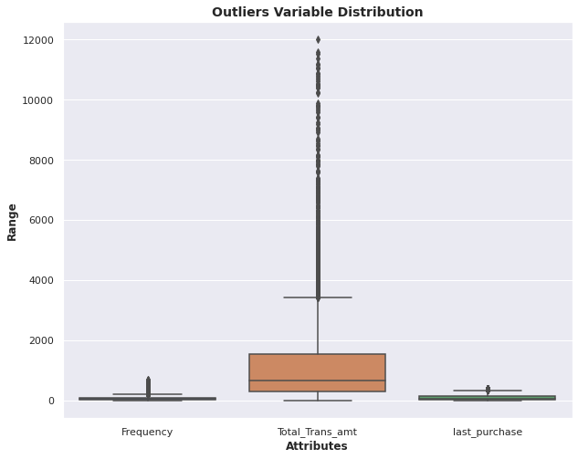
Model Preparation
Outliers – Detected and Removed

Slide 13
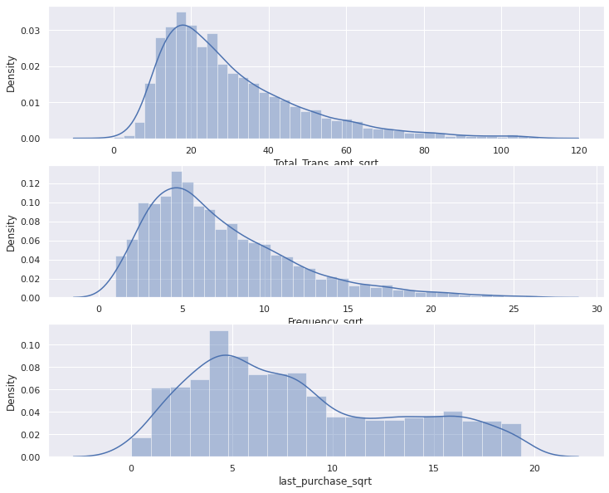
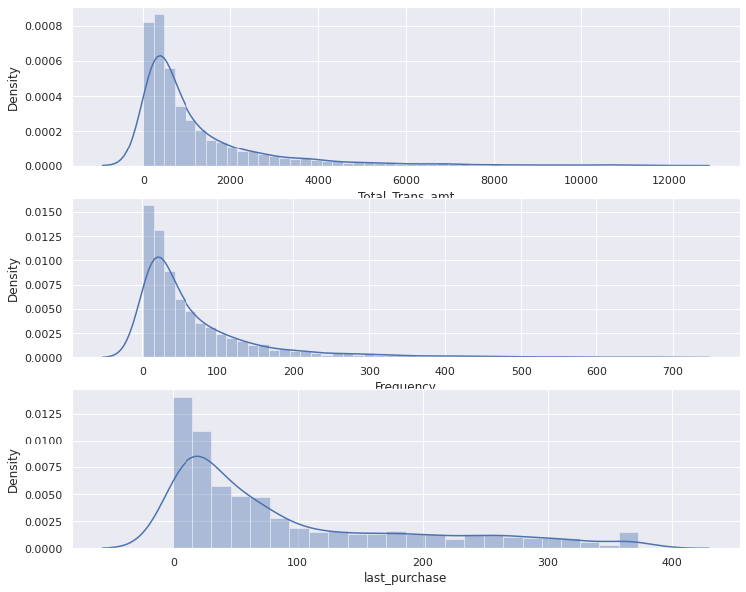
Model Preparation
Distribution – Skewed and changed

Slide 14
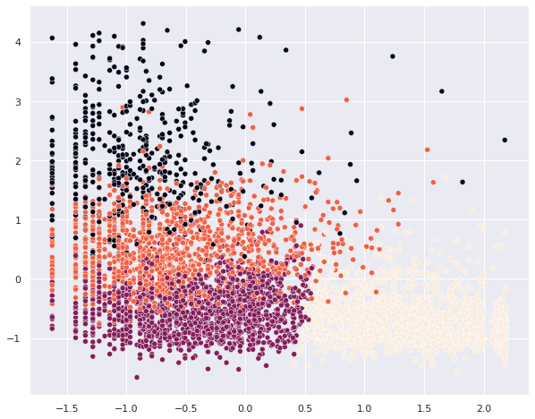
Model
Predicting random with the value k = 4

Slide 15
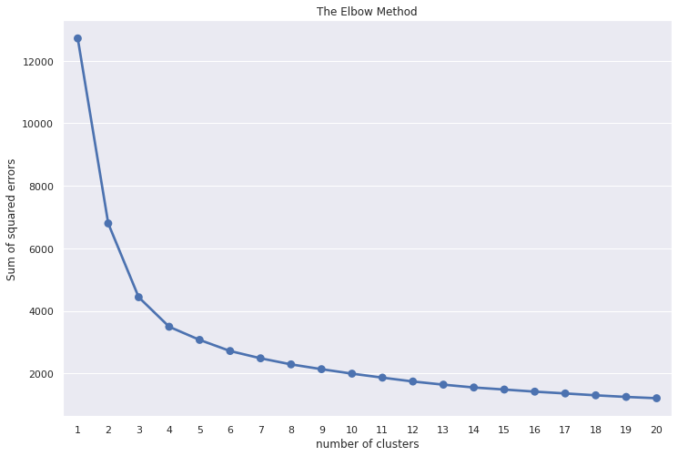
Model
Checking Optimum number by Elbow Method

Slide 16
Model
Checking Optimum number by silhouette_score
For n_clusters = 3, silhouette score is 0.3901851051400997
For n_clusters = 4, silhouette score is 0.36008578655260715
For n_clusters = 5, silhouette score is 0.345233582260781
For n_clusters = 6, silhouette score is 0.32333778722785445
For n_clusters = 7, silhouette score is 0.30955277320067265
For n_clusters = 8, silhouette score is 0.2889574872277081
So for K = 3, we had the highest score

Slide 17
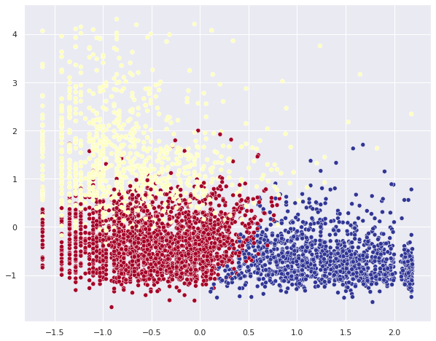
Model
Cluster for K = 3

Slide 18
Conclusions
There were 8 features in total, from which we have extracted 3 only
From those three, we first plotted the cluster with random value 4, but later on we checked it with 2 different techniques
We have used the Elbow method for having the range of cluster numbers - we had range [3,8]
We checked this range, by the help of Silhoutte Score, the number 3 was giving the highest score in the given data, so we have chosen k = 3
At the end we have plotted the cluster visualization with 3 different clusters.

